Slide 1
SOFTWARE DESIGN AND ARCHITECTURE
THEORY LECTURE and Practical#11
BEHAVIORAL DESIGN PATTERNS
(OBSERVER PATTERN)

Slide 2
Intent
Define a one-to-many dependency between objects so that when one object changes state, all its dependents are notified and updated automatically.
Also known as: Dependents, Publish-Subscribe

Slide 3
Motivation
A common side-effect of partitioning a system into a collection of cooperating classes is the need to maintain consistency between related objects. You don't want to achieve consistency by making the classes tightly coupled, because that reduces their reusability.
For example, many GUI toolkits separate the presentational aspects of the user interface from the underlying application. Classes defining application data and presentations can be reused independently. They can work together, too. Both a spreadsheet object and bar chart object can depict information in the same application data object using different presentations. The spreadsheet and the bar chart don't know about each other, thereby letting you reuse only the one you need. But they behave as though they do. When the user changes the information in the spreadsheet, the bar chart reflects the changes immediately, and vice versa.

Slide 4
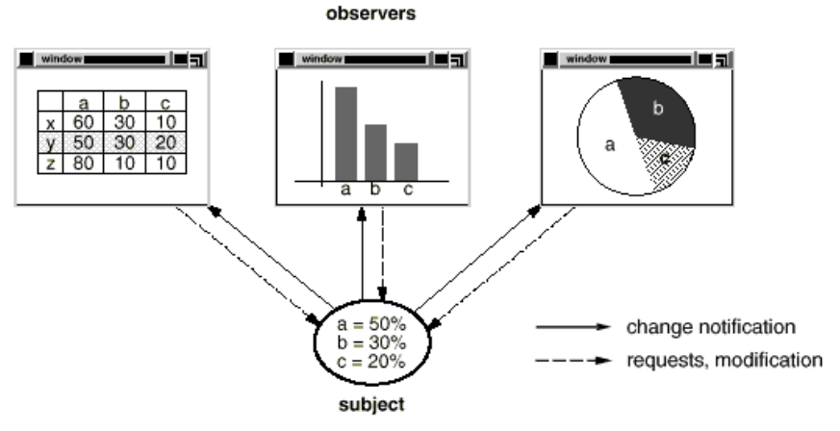
Motivation (cont’d)
This behavior implies that the spreadsheet and bar chart are dependent on the data object and therefore should be notified of any change in its state.
The Observer pattern describes how to establish these relationships. The key objects in this pattern are subject and observer. A subject may have any number of observers. All observers are notified whenever the subject undergoes a change in state. In response, each observer will query the subject to synchronize its state with the subject's state.

Slide 5
Applicability
Use the Observer pattern in any of the following situations:
When an abstraction has two aspects, one dependent on the other. Encapsulating these aspects in separate objects lets you vary and reuse them independently.
When a change to one object requires changing others, and you don't know how many objects need to be changed.
When an object should be able to notify other objects without making assumptions about who these objects are. In other words, you don't want these objects tightly coupled.

Slide 6
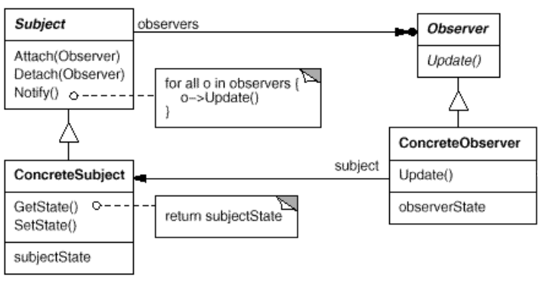
Structure

Slide 7
Participants
Subject
knows its observers. Any number of Observer objects may observe a subject.
provides an interface for attaching and detaching Observer objects.
ConcreteSubject
stores state of interest to ConcreteObserver objects.
sends a notification to its observers when its state changes.
Observer
defines an updating interface for objects that should be notified of changes in a subject.
ConcreteObserver
maintains a reference to a ConcreteSubject object.
stores state that should stay consistent with the subject's.
implements the Observer updating interface to keep its state consistent with the subject's.

Slide 8
Collaborations
ConcreteSubject notifies its observers whenever a change occurs that could make its observers' state inconsistent with its own.
After being informed of a change in the concrete subject, a ConcreteObserver object may query the subject for information. ConcreteObserver uses this information to reconcile its state with that of the subject.

Slide 9
Known use
MVC
Use in JAVA API: HttpSessionBindingListener is an example where Observer design pattern in used in Java API.
Notes:
View is base for all observers.

Slide 10
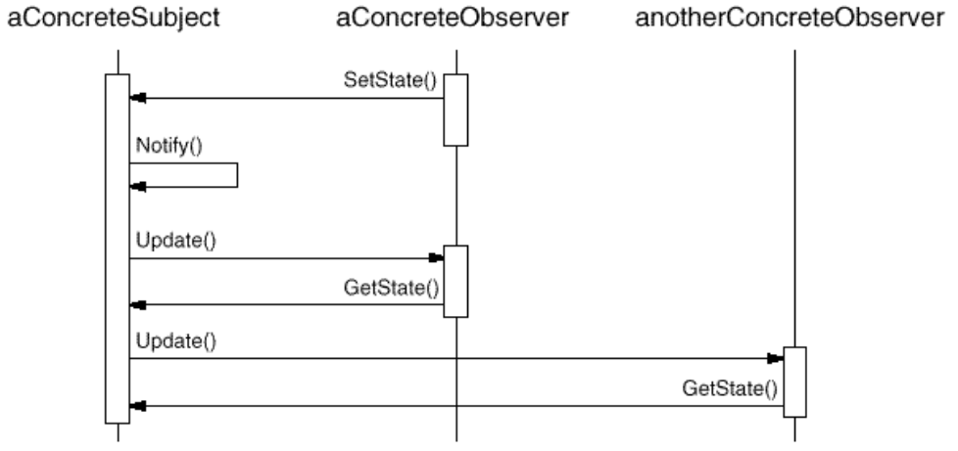

Slide 11
Sample code
Let us take data and converter observers example for observer design pattern sample implementation.

Slide 12
Subject.java
public interface Subject{
public int getState();
public void setState(int state);
public void attach(Observer observer);
public void notifyAllObservers();
}

Slide 13
Data.java (ConcreteSubject)
import java.util.ArrayList;
import java.util.List;
public class Data implements Subject {
private List<Observer> observers = new ArrayList<Observer>();
private int state;
public int getState() { return state; }
public void setState(int state) {
this.state = state;
notifyAllObservers();
}
public void attach(Observer observer){
observers.add(observer); }
public void notifyAllObservers(){
for (Observer observer : observers) {
observer.update();
}
}
}

Slide 14
Observer.java
public abstract class Observer {
protected Subject subject;
public abstract void update();
}

Slide 15
BinaryObserver.java (ConcreteObserver)
public class BinaryObserver extends Observer{
public BinaryObserver(Subject subject){
this.subject = subject;
this.subject.attach(this); }
public void update() {
System.out.println( "Binary String: " + Integer.toBinaryString( subject.getState() ) );
}
}

Slide 16
OctalObserver.java (ConcreteObserver)
public class OctalObserver extends Observer{
public OctalObserver(Subject subject){
this.subject = subject;
this.subject.attach(this);
}
public void update() {
System.out.println( "Octal String: " + Integer.toOctalString( subject.getState() ) );
}
}

Slide 17
HexaObserver.java (ConcreteObserver)
public class HexaObserver extends Observer{
public HexaObserver(Subject subject){
this.subject = subject;
this.subject.attach(this); }
public void update() {
System.out.println( "Hex String: " + Integer.toHexString( subject.getState() ).toUpperCase() );
}
}

Slide 18
public class TestPattern{
public static void main(String[] args){
Subject sub=new Data();
new BinaryObserver(sub);
new OctalObserver(sub);
new HexaObserver(sub);
System.out.print(“testing with 10”);
sub.setState(10);
System.out.print(“testing with 15”);
sub.setState(15);
}
}

Slide 19
Task
Implement the observer pattern for the following UML diagram:

Slide 20
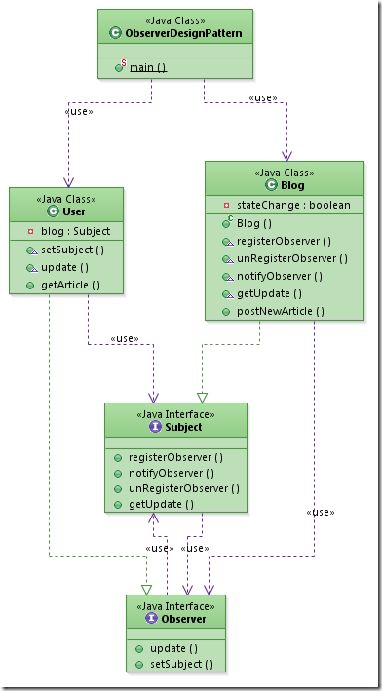
Example UML

